Slide 1
How do we develop two systems for mindreading?
Ian Apperly

Slide 2
What is “Theory of Mind”?
“Folk psychology”, “Perspective-taking”, “Social cognition”
Essential for everyday social interaction and communication
False belief tasks as a paradigm case
(e.g., Wimmer & Perner, 1983)
These tasks ensure that participant must judge from other person’s point of view
Notes:
After more than 30 years, we are clearly better informed

Slide 3
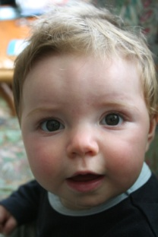
What is “Theory of Mind”?
“Folk psychology”, “Perspective-taking”, “Social cognition”
Essential for everyday social interaction and communication
False belief tasks as a paradigm case
(e.g., Wimmer & Perner, 1983)
These tasks ensure that participant must judge from other person’s point of view
Significant developments from infancy to early childhood
Disproportionately impaired in autism and several other
genetic and psychiatric disorders
Notes:
After more than 30 years, we are clearly better informed

Slide 4


What is “Theory of Mind”?
“Folk psychology”, “Perspective-taking”, “Social cognition”
Essential for everyday social interaction and communication
False belief tasks as a paradigm case
(e.g., Wimmer & Perner, 1983)
These tasks ensure that participant must judge from other person’s point of view
Significant developments from infancy to early childhood
Disproportionately impaired in autism and several other
genetic and psychiatric disorders
Existent, to a degree, in non-human animals
Notes:
After more than 30 years, we are clearly better informed

Slide 5
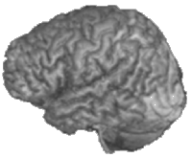
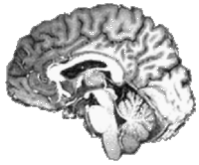
What is “Theory of Mind”?
“Folk psychology”, “Perspective-taking”, “Social cognition”
Essential for everyday social interaction and communication
False belief tasks as a paradigm case
(e.g., Wimmer & Perner, 1983)
These tasks ensure that participant must judge from other person’s point of view
Significant developments from infancy to early childhood
Disproportionately impaired in autism and several other
genetic and psychiatric disorders
Existent, to a degree, in non-human animals
Identifiable neural network
Temporo-parietal junction / pSTS
Temporal pole
Medial prefrontal cortex
TPJ
mPFC
TP
Lateral view
Medial view
Notes:
After more than 30 years, we are clearly better informed

Slide 6
Theory of mind in adults?
“But don’t adults have a theory of mind……?”

Slide 7
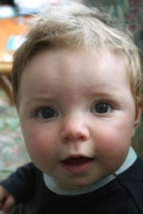
Theory of mind in adults?
“But don’t adults have a theory of mind……?”
Prevailing view:
ToM is a set of concepts
Researchers should figure out who has them (and where they are in the brain).....
....by seeing who passes false belief tasks
Temporo-parietal junction / pSTS
Temporal pole
Medial prefrontal cortex
TPJ
mPFC
TP
Lateral view
Medial view

Slide 8
Theory of mind in adults?
“But don’t adults have a theory of mind……?”
Prevailing view:
ToM is a set of concepts
Researchers should figure out who has them (and where they are in the brain).....
....by seeing who passes false belief tasks
Problems with this view:
No cognitive account of ToM in adults
Severe limitations on conceptualising extended development, neural basis and disorder
Little integration with the rest of cognition
Temporo-parietal junction / pSTS
Temporal pole
Medial prefrontal cortex
TPJ
mPFC
TP
Lateral view
Medial view
Notes:
NICE : We must use this!

Slide 9
“Contradictory” findings from children vs. infants and non-human animals
Significant developments in ToM reasoning between 2 and 7 years (e.g., Wellman, Cross & Watson, 2001)
Strong links with language and executive function
Growing evidence of “false belief” reasoning in infants
24M (Southgate, Semju & Csibra, 2007)
15M (Onishi & Baillargeon, 2005; 2010)
13M (Surian, Caldi & Sperber, 2007)
7M (Kovacs et al., 2010)
Evidence for something similar in non-human animals
Hare, Call & Tomasello (2000, 2001)
Clayton, Dally & Emery (2007)
But infants and non-human animals clearly lack the language and executive resources that appear necessary for development of belief reasoning

Slide 10
Today’s talk:
Why should we think adults might have two systems for mindreading?
Evidence that they do
What is the relationship between the abilities of infants, children and adults?
(NB. I don’t have all the answers, but I hope to indicate some of the questions we should ask!)

Slide 11
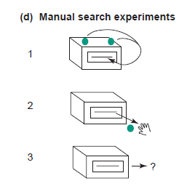
Example from the psychology of number
Pre-counting infants search ~N times for N items for N<4
From Feigenson, Dehane & Spelke (2004)

Slide 12
Example from the psychology of number
Pre-counting infants search ~N times for N items for N<4
People who can count are not subject to this limit....
From Feigenson, Dehane & Spelke (2004)

Slide 13
Example from the psychology of number
Pre-counting infants search ~N times for N items for N<4
People who can count are not subject to this limit....
....provided they have time and resources
From Feigenson, Dehane & Spelke (2004)

Slide 14
Why two (or more) systems?
Complex cognitive domains often make contradictory demands
We must be very efficient
We must be very flexible

Slide 15
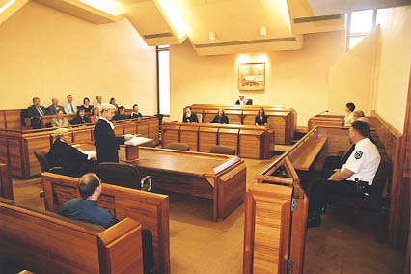
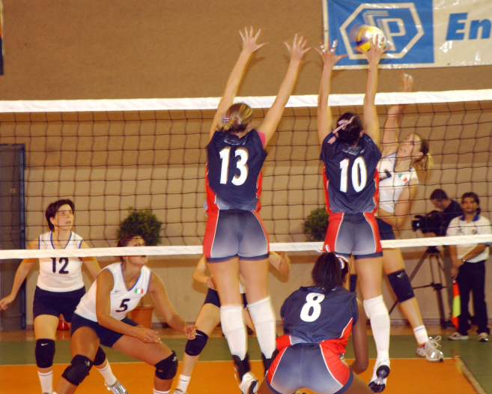

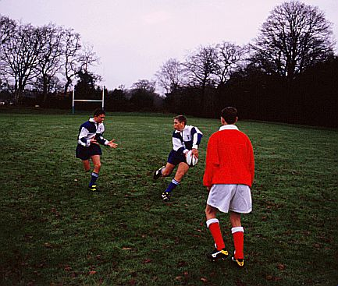
Mindreading makes contradictory demands
ToM must be flexible
- An archetypal “central process”
ToM must be fast and efficient
- An archetypal “modular process”
Fast &
Flexible?

Slide 16
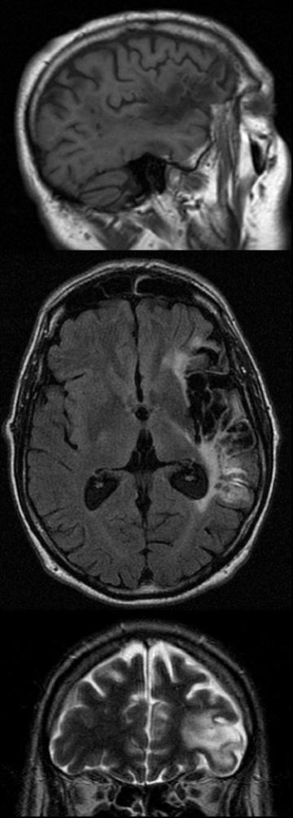
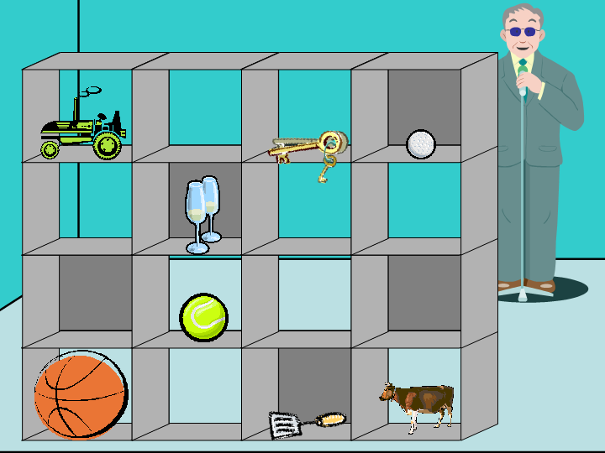
Evidence that mindreading is a flexible but demanding ability
In Adults....
Impaired executive processes can lead to severe egocentrism
(e.g., Samson, Apperly, Kathirgamanathan & Humphreys, 2005)
Belief inferences are not made automatically
(Apperly, Samson, Riggs, Simpson & Chiavarino, 2006; Back & Apperly, 2010)
Belief inferences are not used automatically
(e.g., Keysar, Lin & Barr, 2003; Apperly et al., 2010)
Holding false beliefs briefly in mind has a measurable processing cost
(Apperly, Back et al., 2008)
Belief reasoning requires cognitive control
(e.g., Bull, Philips & Conway, 2007)
.
Notes:
***CHECK REFS

Slide 17
Evidence that mindreading is a flexible but demanding ability
In Adults....
Impaired executive processes can lead to severe egocentrism
(e.g., Samson, Apperly, Kathirgamanathan & Humphreys, 2005)
Belief inferences are not made automatically
(Apperly, Samson, Riggs, Simpson & Chiavarino, 2006; Back & Apperly, 2010)
Belief inferences are not used automatically
(e.g., Keysar, Lin & Barr, 2003; Apperly et al., 2010)
Holding false beliefs briefly in mind has a measurable processing cost
(Apperly, Back et al., 2008)
Belief reasoning requires cognitive control
(e.g., Bull, Philips & Conway, 2007)
...and this fits with evidence from children.

Slide 18
Efficient but inflexible processes?
What would count as direct evidence of inflexibility and efficiency?
Kovacs et al. (2010) Science. Adults may infer false beliefs even when they do not need to.
Stronger evidence:
Process may be executed even when unnecessary or unhelpful
Process may not be disrupted by other tasks

Slide 19
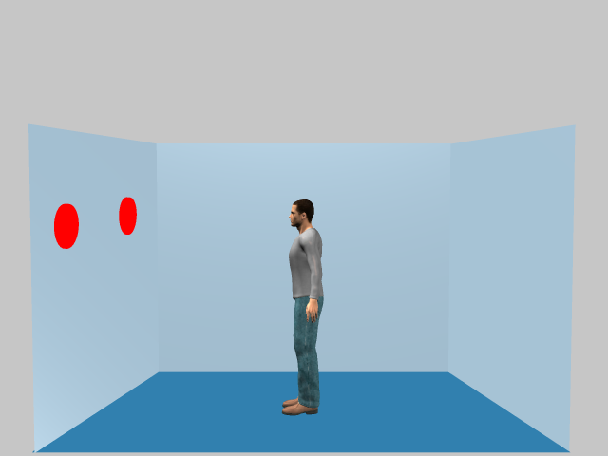
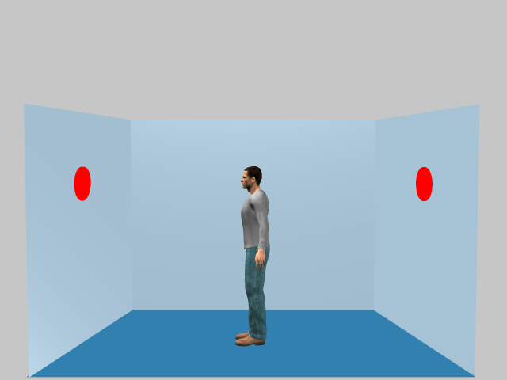
Efficient but inflexible processes? (Samson, Apperly, Braithwaite et al., 2010, JEP:HPP)
Self / Other Consistent
1,2, or 3 discs
You / He
2
Disc position varies
Self / Other Inconsistent
You / He
2

Slide 20
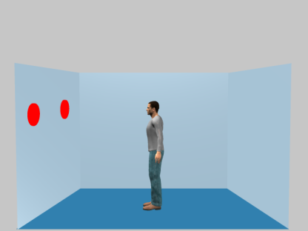

Efficient but inflexible processes? (Samson, Apperly, Braithwaite et al., 2010, JEP:HPP)
Egocentric interference on explicit judgement of other
RT (ms)
Main effect of consistency
Significant interaction

Slide 21
Efficient but inflexible processes? (Samson, Apperly, Braithwaite et al., 2010, JEP:HPP)
Altercentric interference = indirect measure of perspective-taking
RT (ms)
Main effect of consistency
Significant interaction

Slide 22
Efficient but inflexible processes? (Samson, Apperly, Braithwaite et al., 2010, JEP:HPP)
Effect occurs:
- Even when you only ever judge self
- Even when you do an executive task at the same time (Qureshi, Apperly & Samson, 2010, Cognition).
Altercentric interference = indirect measure of perspective-taking
RT (ms)
Main effect of consistency
Significant interaction

Slide 23
Efficient but inflexible processes?
What would count as direct evidence of inflexibility and efficiency?
Process may be executed even when unnecessary or unhelpful
Process may not be disrupted by other tasks

Slide 24
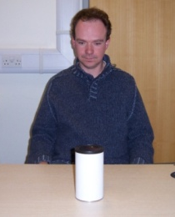

Two systems for mindreading
These contrasting characteristics suggest separate “systems” for mindreading
Where might they come from?

Slide 25
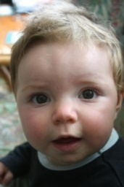
Where do adults’ two systems come from?
Infant system must be relatively “efficient”

Slide 26
Where do adults’ two systems come from?
Infant system develops
Language, Executive function, Knowledge

Slide 27
Where do adults’ two systems come from?
Infant system develops
Language, Executive function, Knowledge

Slide 28
Where do adults’ two systems come from?
Infant system develops
Language, Executive function, Knowledge
Automatisation

Slide 29
Where do adults’ two systems come from?
Infant system develops
Language, Executive function, Knowledge
Automatisation
This is the origin of “automatic addition” (e.g., Le Fevre et al, 1988)

Slide 30

Where do adults’ two systems come from?
Infant system develops
Language, Executive function, Knowledge
Automatisation
Infant system preserved

Slide 31
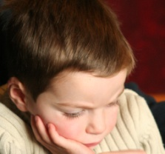
Where do adults’ two systems come from?
Infant system develops
Language, Executive function, Knowledge
Automatisation
Infant system preserved
Language, Executive function, Knowledge

Slide 32
Where do adults’ two systems come from?
Infant system develops
Language, Executive function, Knowledge
Automatisation
Infant system preserved
Language, Executive function, Knowledge

Slide 33
Where do adults’ two systems come from?
Infant system develops
Language, Executive function, Knowledge
Automatisation
This is the Carey/Spelke view of most findings in infant cognition of number and other domains (e.g., Carey, 2009)
Infant system preserved
Language, Executive function, Knowledge

Slide 34
Two points of investigation
Infant system develops
Language, Executive function, Knowledge
Automatisation
Automatisation?
Efficient processing should be limited
Infant system preserved
Language, Executive function, Knowledge

Slide 35
What is the origin of automatic perspective-taking?
Altercentric interference = indirect measure of perspective-taking
RT (ms)
Main effect of consistency
Significant interaction

Slide 36
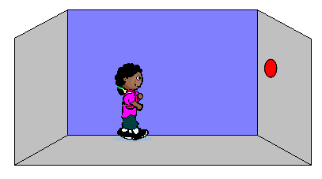
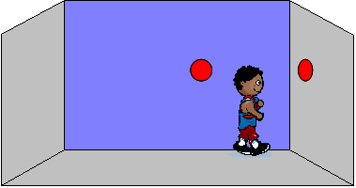
Evidence for automatisation? Surtees & Apperly (In press) Child Development
120 children aged 6-10 and adults
Expect younger children to suffer less interference for self judgements.
“You see 2”
Or
“He sees 2”

Slide 37
Evidence for automatisation? Surtees & Apperly (In press) Child Development
120 children aged 6-10 and adults
“You see 2”
Or
“He sees 2”

Slide 38
Evidence for automatisation? Surtees & Apperly (In press) Child Development
120 children aged 6-10 and adults
“You see 2”
Or
“He sees 2”
No evidence of automatization
But perhaps children had already automatised?

Slide 39
Where do adults’ two systems come from?
Infant system develops
Language, Executive function, Knowledge
Automatisation
No evidence of automatization
Infant system preserved
Language, Executive function, Knowledge

Slide 40
Limits on “efficient” mindreading?
Infant system develops
Language, Executive function, Knowledge
Automatisation
Cognitive efficiency does not come for free
Infant system preserved
Language, Executive function, Knowledge

Slide 41
Limits on “efficient” mindreading?
Infant system develops
Language, Executive function, Knowledge
Automatisation
Cognitive efficiency does not come for free
Infant system preserved
Language, Executive function, Knowledge

Slide 42
Limits on “efficient” mindreading?
Infant system develops
Language, Executive function, Knowledge
Automatisation
Cognitive efficiency does not come for free...
Only this account predict analogous limits.
(As seen for number....)
Infant system preserved
Language, Executive function, Knowledge

Slide 43
Flavell et al (1981)
Level-1
Age~2
representation of:
agent-object
Corresponds to the experiments described so far
Level-2
Age~4
representation of: agent-proposition

Slide 44
Flavell et al (1981)
Level-1
Age~2
representation of:
agent-object
Corresponds to the experiments described so far
Level-2
Age~4
representation of: agent-proposition
Existing evidence suggests that infants (and non-human animals) are limited to L1-type problems.

Slide 45


Slide 46
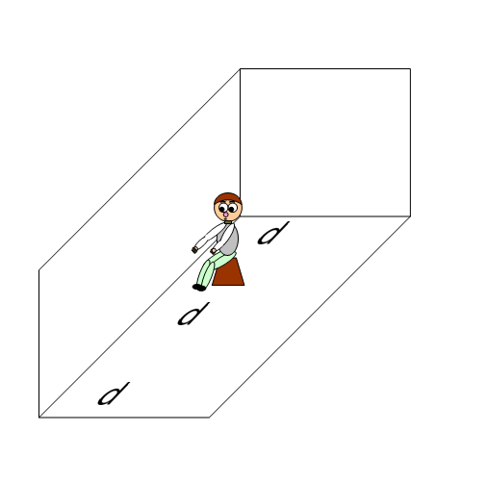
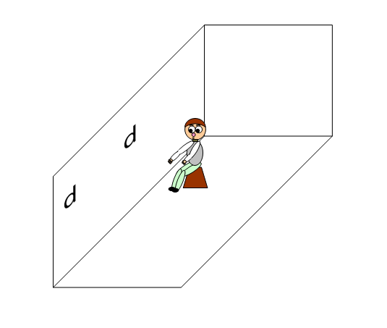
Surtees & Apperly (submitted) Surtees, Butterfill & Apperly (submitted)
Consistent perspectives
Inconsistent perspectives
L1 perspective-difference:
He sees 2 vs. you see 3
L2 perspective difference
He sees “p” vs. you see “d”

Slide 47
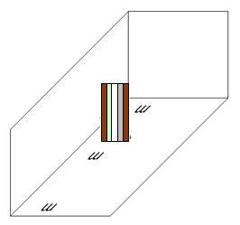
Surtees & Apperly (submitted)
Consistent perspectives
Inconsistent perspectives
L1 perspective-difference:
He sees 2 vs. you see 3
L2 perspective difference
He sees “p” vs. you see “d”
Baseline

Slide 48
Surtees & Apperly (submitted)
Consistent perspectives
Inconsistent perspectives
Critical Question;
For Self judgements, compared to baseline, does the presence of an irrelevant perspective make any difference to L1 or L2 judgements?
Baseline

Slide 49
L1 shows automaticity
Surtees & Apperly (in prep)
For “Self” judgements
Perspective
Baseline
Processing cost (RT/Prop.correct)
*
Perspective
Baseline
Perspective
Baseline

Slide 50
L1 shows automaticity L2 does not
For “Self” judgements
Perspective
Baseline
Processing cost (RT/Prop.correct)
*
Perspective
Baseline
Perspective
Baseline

Slide 51
Surtees & Apperly (submitted) Surtees, Butterfill & Apperly (submitted)
Consistent perspectives
Inconsistent perspectives
L1 perspective-difference:
He sees 2 vs. you see 3
L2 perspective difference
He sees “p” vs. you see “d”
We replicate evidence of automatic, stimulus-driven Level-1 perspective-taking.
We find no evidence of automaticity for Level-2 perspectives

Slide 52
Limits on “efficient” mindreading?
Infant system develops
Language, Executive function, Knowledge
Automatisation
Evidence for analogous limits.
No evidence for propositional content.
Infant system preserved
Language, Executive function, Knowledge

Slide 53


Limits on “efficient” mindreading?
Infant system develops
Language, Executive function, Knowledge
Automatisation
Evidence for analogous limits.
No evidence for propositional content.
(Same for infant false belief studies)
Infant system preserved
Language, Executive function, Knowledge

Slide 54
Summary
Automatisation
Language, Executive function, Knowledge
We must explain how mindreading can be both flexible and efficient.
“2-system” accounts offer a solution.
This should make us think hard about development.
There are tractable ways of testing between alternative models

Slide 56
Surtees & Apperly (submitted) Surtees, Butterfill & Apperly (submitted)
Consistent perspectives
Inconsistent perspectives
L1 perspective-difference:
He sees 2 vs. you see 3
L2 perspective difference
He sees “p” vs. you see “d”

Slide 57
Surtees & Apperly (in prep)
Consistent perspectives
Inconsistent perspectives
L1 perspective-difference:
He sees 2 vs. you see 3
L2 perspective difference
He sees “p” vs. you see “d”
Baseline

Slide 58
Surtees & Apperly (in prep)
Consistent perspectives
Inconsistent perspectives
Critical Question;
For Self judgements, compared to baseline, does the presence of an irrelevant perspective make any difference to L1 or L2 judgements?
Baseline

Slide 59
L1 shows automaticity
Surtees & Apperly (in prep)
For “Self” judgements
Perspective
Baseline
Processing cost (RT/Prop.correct)
*
Perspective
Baseline
Perspective
Baseline

Slide 60
L1 shows automaticity L2 does not
For “Self” judgements
Perspective
Baseline
Processing cost (RT/Prop.correct)
*
Perspective
Baseline
Perspective
Baseline

Slide 61
The same is true across a wide age range
Surtees & Apperly (in prep, b)
6
7
8
9
10
Age in years

Slide 62
Flavell et al (1981)
Level-1
Age~2
representation of:
agent-object
Corresponds to the experiments described so far
Level-2
Age~4
representation of: agent-proposition
No evidence of automaticity

Slide 63
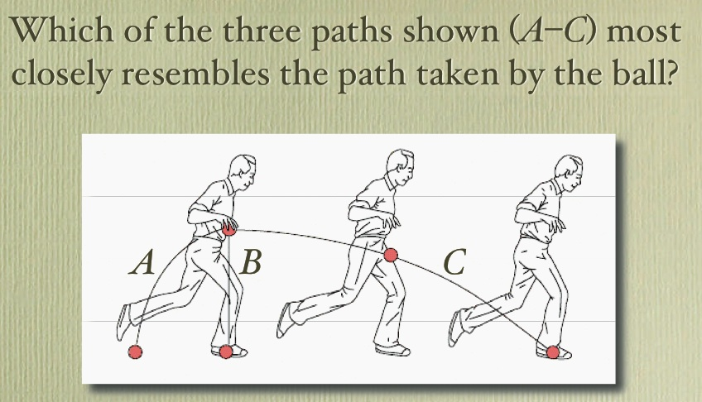
Example from the psychology of trajectories
If these judgements guided catching, we would not catch balls.
McCloskey, Intuitive Physics, Scientific American 248 (1983),

Slide 64
Example from the psychology of trajectories
v
θ
Launch
Impact
Newton
What Newton would have done.....
A) Derive equation for trajectory of ball.
B) Derive equation for one’s own capacity to move.
Solve A and B simultaneously

Slide 65
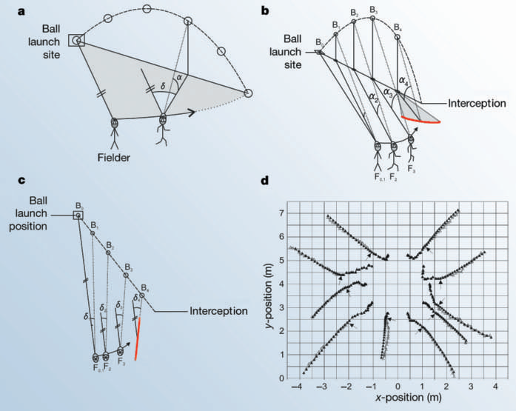
Example from the psychology of trajectories
What England Cricketers do...
Fielders run so that their angle of gaze elevation to the ball increases at a decreasing rate, while their horizontal gaze angle to the ball increases at a constant rate (McLeod, Reed and Dienes, 2003)

